Slide 1

The for Loop
To execute a sequence of statements a given number of times:
Could use a while loop controlled by a counter
int counter = 1; // Initialize the counter
while (counter <= 10) // Check the counter
{
System.out.println(counter);
counter++; // Update the counter
}
Use a special type of loop called for loop
for (int counter = 1; counter <= 10; counter++)
{
System.out.println(counter);
}

Slide 2
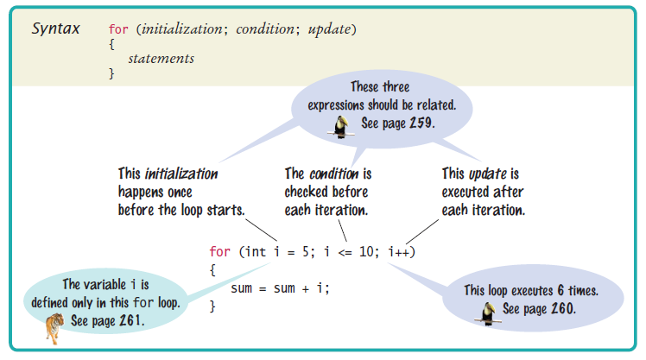
Syntax 6.2 for Statement

Slide 3
The for Loop
A for loop can count down instead of up:
for (int counter = 10; counter >= 0; counter--) . . .
The increment or decrement need not be in steps of 1:
for (int counter = 0; counter <= 10; counter = counter + 2) . . .

Slide 4
The for Loop
If the counter variable is defined in the loop header,
It does not exist after the loop
for (int counter = 1; counter <= 10; counter++)
{
. . .
}
// counter no longer declared here
If you declare the counter variable before the loop,
You can continue to use it after the loop
int counter;
for (counter = 1; counter <= 10; counter++)
{
. . .
}
// counter still declared here

Slide 5
The for Loop
To traverse all the characters of a string:
for (int i = 0; i < str.length(); i++)
{
char ch = str.charAt(i);
Process ch.
}
The counter variable i starts at 0, and the loop is terminated when i reaches the length of the string.

Slide 6
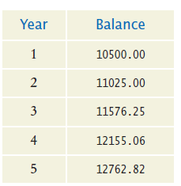
The for Loop
To compute the growth of our savings account over a period of years,
Use a for loop because the variable year starts at 1 and then moves in constant increments until it reaches the target
for (int year = 1; year <= numberOfYears; year++)
{
Update balance.
}
Table of balances:

Slide 7
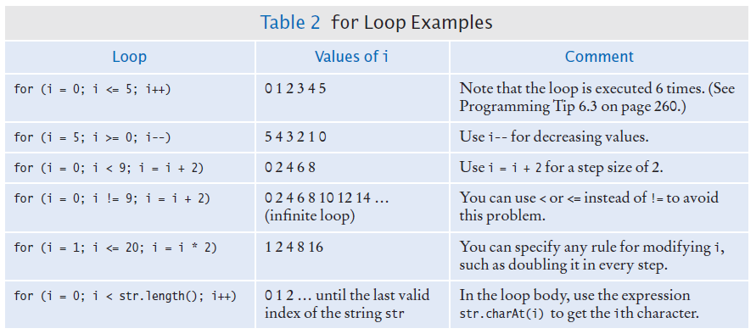
The for Loop Examples

Slide 8
Self Check 6.12
How many numbers does this loop print?
for (int n = 10; n >= 0; n--)
{
System.out.println(n);
}
Answer: 11 numbers: 10 9 8 7 6 5 4 3 2 1 0

Slide 9
Self Check 6.13
Write a for loop that prints all even numbers between 10 and 20 (inclusive).
Answer:
for (int i = 10; i <= 20; i = i + 2)
{
System.out.println(i);
}

Slide 10
Self Check 6.14
Write a for loop that computes the sum of the integers from 1 to n.
Answer:
int sum = 0;
for (int i = 1; i <= n; i++)
{
sum = sum + I;
}

Slide 11
Sum of all odd numbers between a and b inclusive
A | B | sum
10 | 15 | 0
11 |  | 11
12
13 |  | 24
14
15 |  | 39
If you are struggling with the logic you may find it helpful to go from a table where you did the work to your code. So here I have done a=10 and b=15. Of course I also want to keep track of sum so it is fairly obvious I need that as a column in my table.

Slide 12
Sum of all odd numbers between a and b inclusive
a | b | sum
10 | 15 | 0
11 |  | 11
12
13 |  | 24
14
15 |  | 39
After you have worked it through by hand you can see what is happening here. b is not changing past its initial value so I will not have any assignment statement setting the value of b after that.
a is changing so I need an assignment statement for a. It is being incremented by 1. So either:
a++;
Or
a = a + 1;

Slide 13
Sum of all odd numbers between a and b inclusive
a | b | sum
10 | 15 | 0
11 |  | 11
12
13 |  | 24
14
15 |  | 39
sum is also changing so I better have an assignment statement for sum.
This means I need a sum = ….. ;
What goes in the …. ?
Well we were just adding the value of a to the value of sum and storing it back in sum, so:
sum = sum + a;

Slide 14
Sum of all odd numbers between a and b inclusive
a | b | sum
10 | 15 | 0
11 |  | 11
12
13 |  | 24
14
15 |  | 39
Finally put it all together with the right logic.
I need a loop that steps from a to b (remember that the instructions were to include b)
while (a < = b){
}

Slide 15
Sum of all odd numbers between a and b inclusive
a | b | sum
10 | 15 | 0
11 |  | 11
12
13 |  | 24
14
15 |  | 39
I need to update sum, but only if my current a is odd. I know how to update sum from previous slide so just add the condition.
while (a < = b){
if (a%2 == 1){
sum = sum + a;
}
}

Slide 16
Sum of all odd numbers between a and b inclusive
a | b | sum
10 | 15 | 0
11 |  | 11
12
13 |  | 24
14
15 |  | 39
Then remember we figured out a has to increment..
while (a < = b){
if (a%2 == 1){
sum = sum + a;
}
a++;
}

